Slide 1
HOSTEL MANAGEMENT SYSTEM
ASWATHI K S
S6 MCA
LNCE18MCA017

Slide 2

INTRODUCTION
The “HOSTEL MANAGEMENT SYSTEM” has been developed to override the problems prevailing in the practicing manual system. The software is supported to reduce the hardships faced by the existing system. HOSTEL MAANGEMENT SYSTEM is a web application that aims at computerization of the current procedure of allocating hostel rooms. Currently the process involves students filling up the forms and submitting them in the respective hostel offices which involves a lot of paperwork, hence less efficient. However, every hostel has an administrator and represent using the administrator entity. Eventually they can add, delete, view he student details etc…
It mainly have 3 modules:-
ADMIN
HOSTEL MANAGER
STUDENT

Slide 3
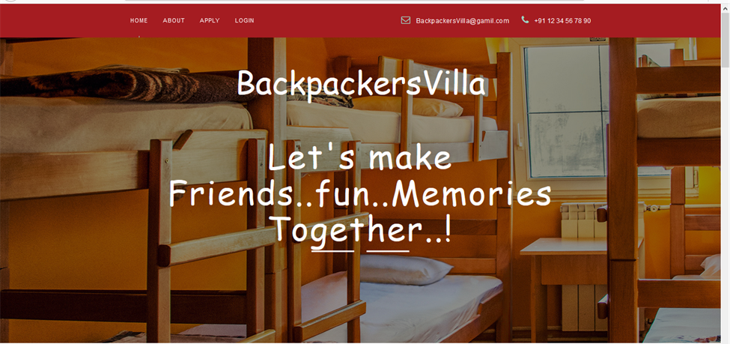
HOME

Slide 4
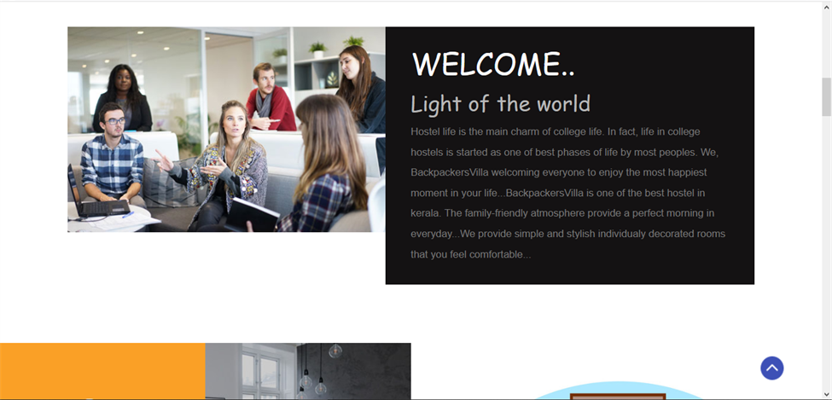
ABOUT

Slide 5
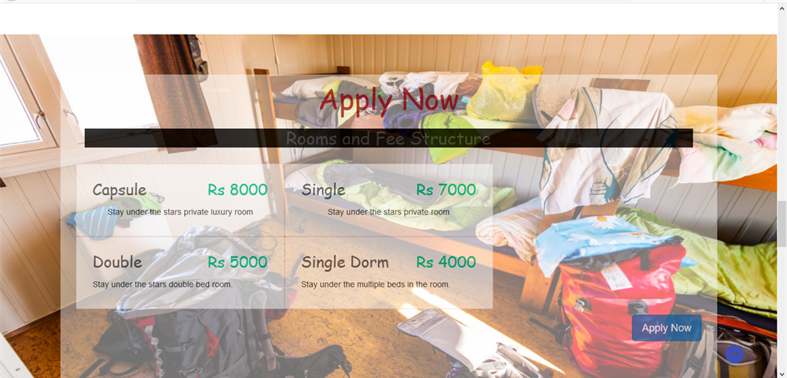
APPLY

Slide 6
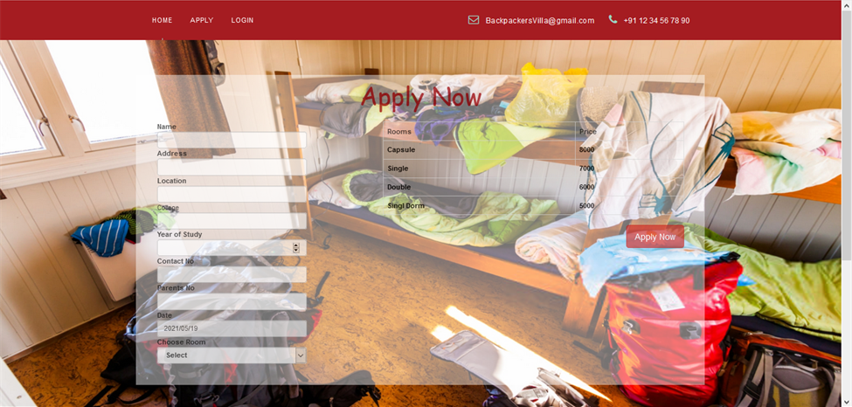

Slide 7
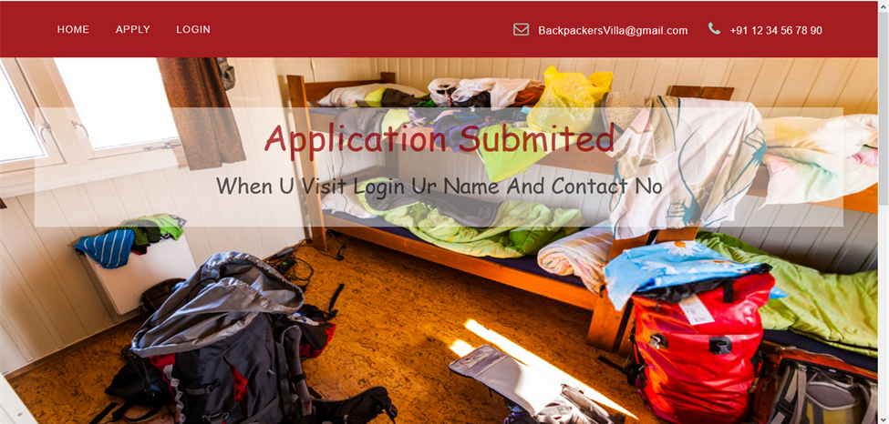

Slide 8
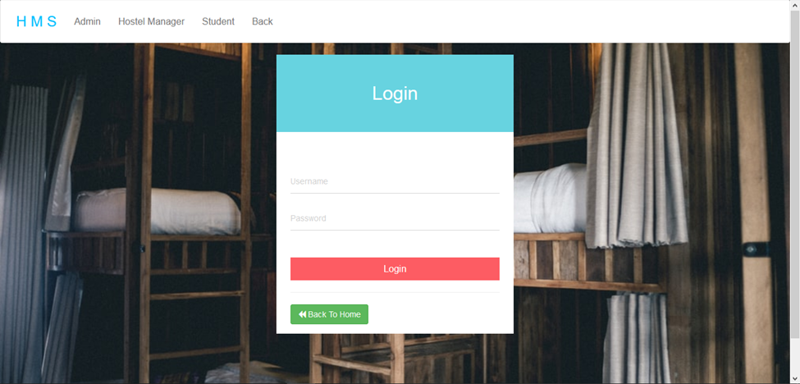
ADMIN

Slide 9
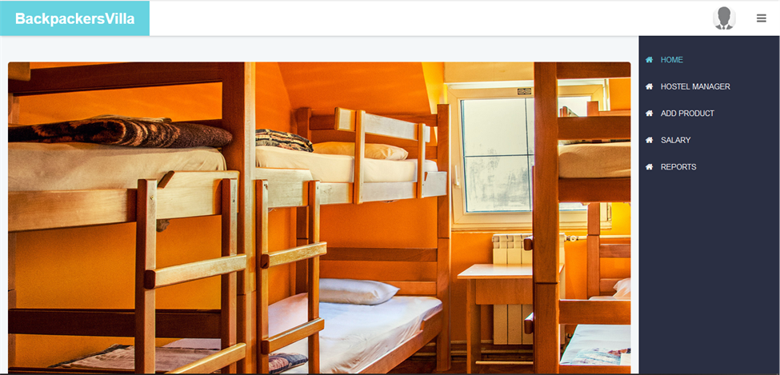

Slide 10
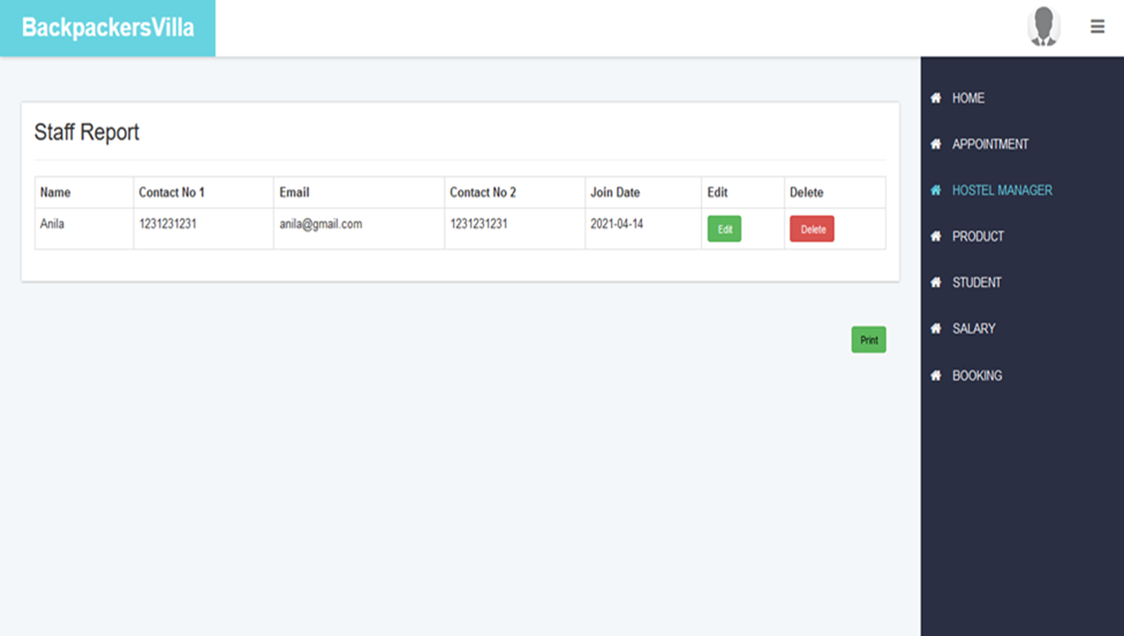

Slide 11
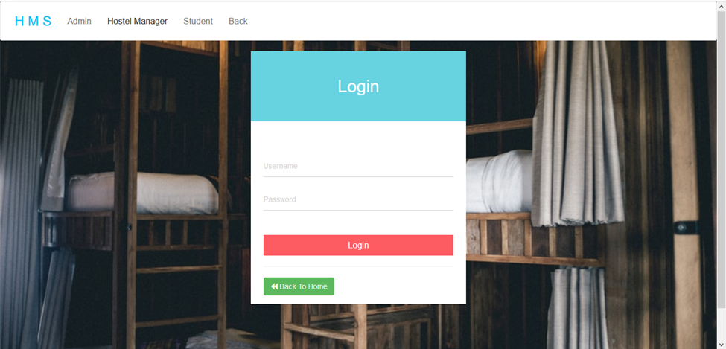
HOSTEL MANAGER

Slide 12
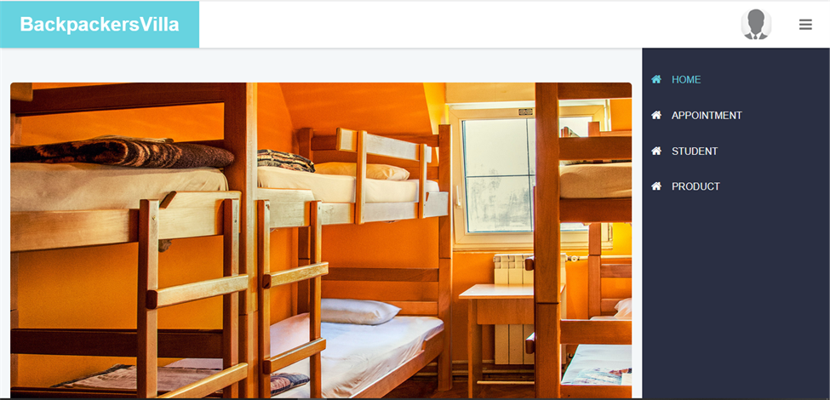

Slide 13
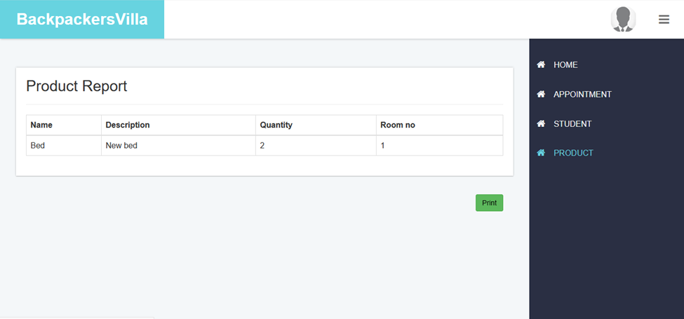

Slide 14
STUDENT
Login
Profile
View Admin & Hostel manager details
Logout

Slide 15
FUTURE OF SCOPE
We can introduce this application in all hostel to reduce the hardships faced by the existing system.
we can any extra features if anything needed
We can discount the price yearwise

Slide 16
CONCLUSION
”Hostel management system” is a user-friendly software for hostels.the Hostel management system is a web application developed in php,html ,css , and mysql. It will be one of helping web application for who searching for an hostel facility.

